Slide 1

THRILL WP 3.4
“Supporting calculations for system design”
Udo Eisenbarth, Yannik Zobus

Slide 2

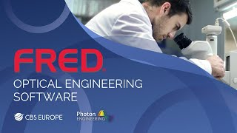



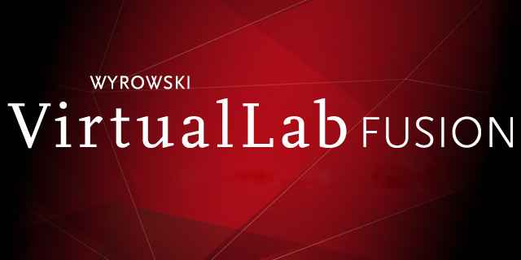
Opossum Yet another optics simulation software ?
Existing solutions:
Proprietary licences
hard / impossible to integrate
expensive
Custom, self-written codes
Often „single-use“ during a thesis
not well maintained
mostly non-compatible with other code
Target specific problems
Often not well-suited for large-size laser systems
Photo by GSI / J. Hosan

Slide 3

Opossum Yet another optics simulation software ?
Existing solutions:
Proprietary licenses
hard / impossible to integrate
expensive
Custom, self-written codes
Often „single-use“ during a thesis
not well maintained
mostly non-compatible with other code
Target specific problems
Often not well-suited for large-size laser systems
Our Approach
Open Source
Platform for custom-code integration
Extensible to specific needs
Design once, use different analysis / modelling methods
Specifically target large laser systems
Holistic approach
Photo by GSI / J. Hosan

Slide 4
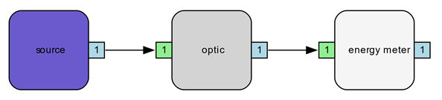

Simulation platform approach
Complete/comprehensive modeling of high-intensity laser systems
Complex system, consisting of similarly complex sub-systems
Requires multitude of analyses/models/calculations
OPOSSUM simulation platform
Model arbitrary optical systems as acyclic directed graphs
"light" flowing as data between nodes
Each node with specific "analyze" functions
Integration of external code as custom node
Different analyzer modes: energy, raytracing, fourier etc.
"analyze" function
Internal / external code
Written in Rust
Memory safe / efficient
Fast, modern
Easy inclusion of external code (e.g. C/C++, Python, Julia...)
"light" data
spectrum, energy, phase, nearfield...
"report" function
Photo by GSI / J. Hosan

Slide 5
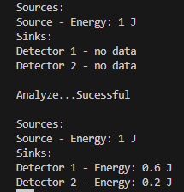
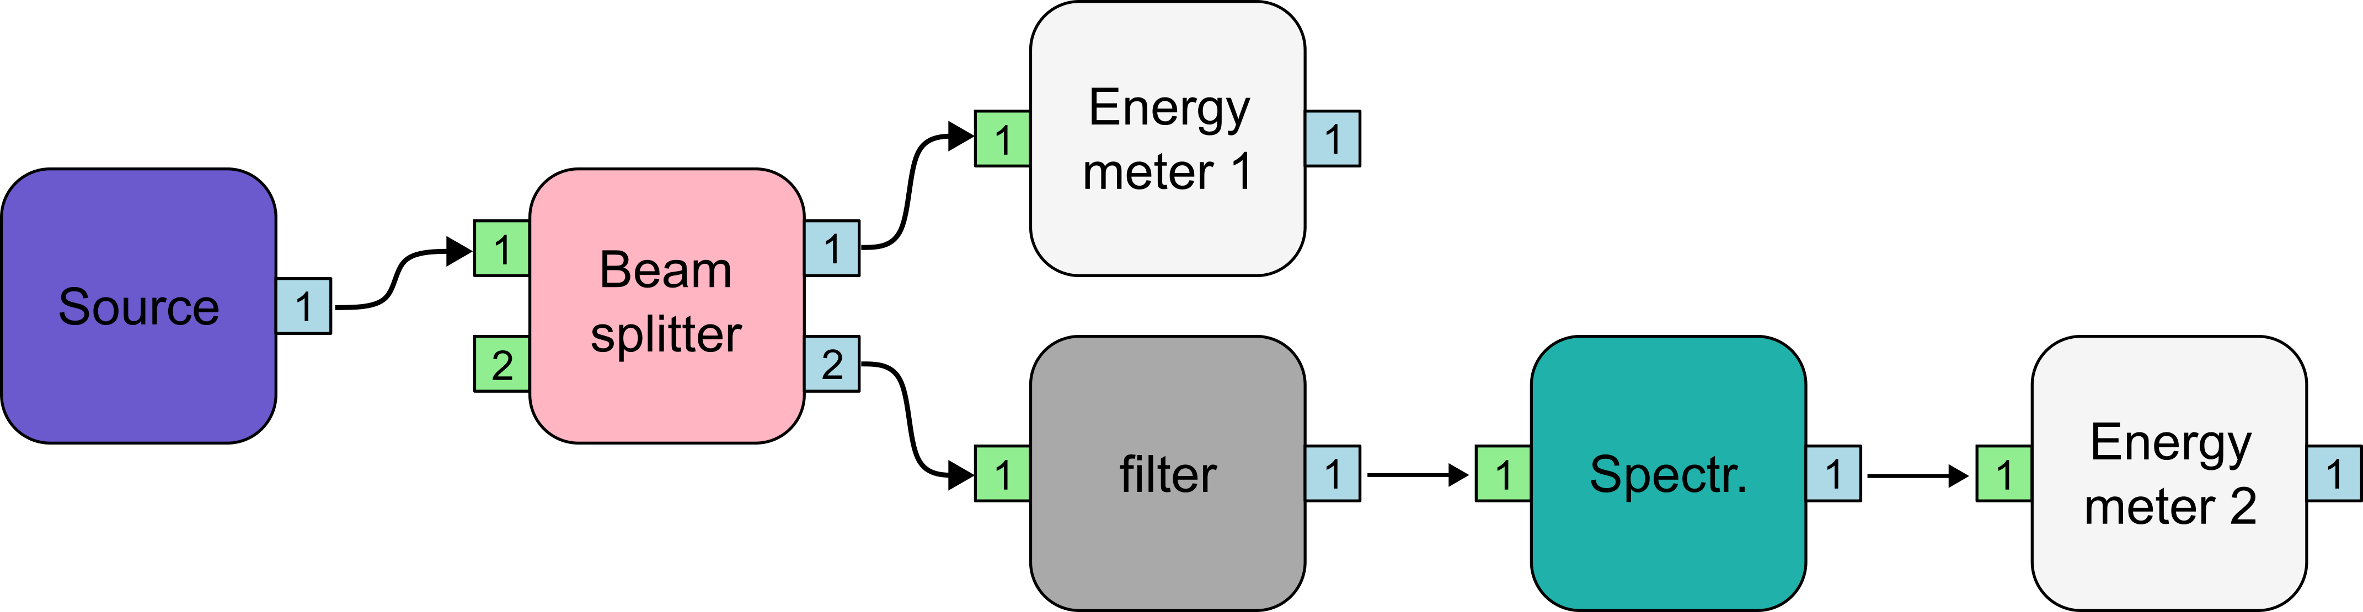

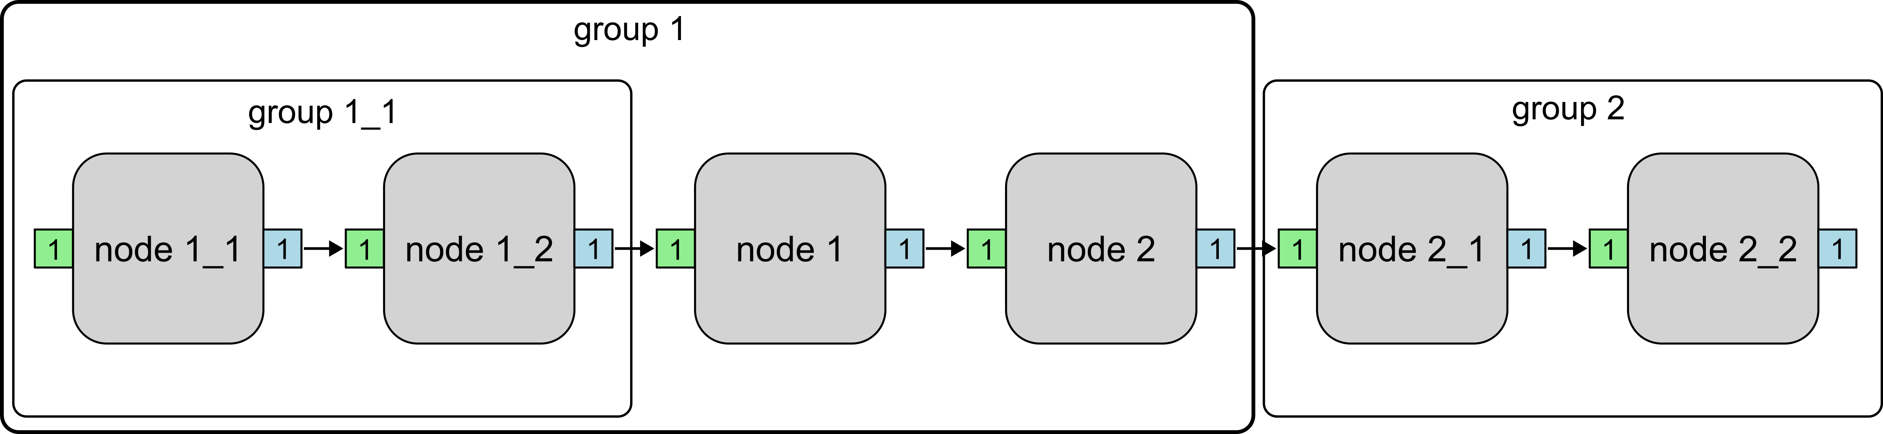

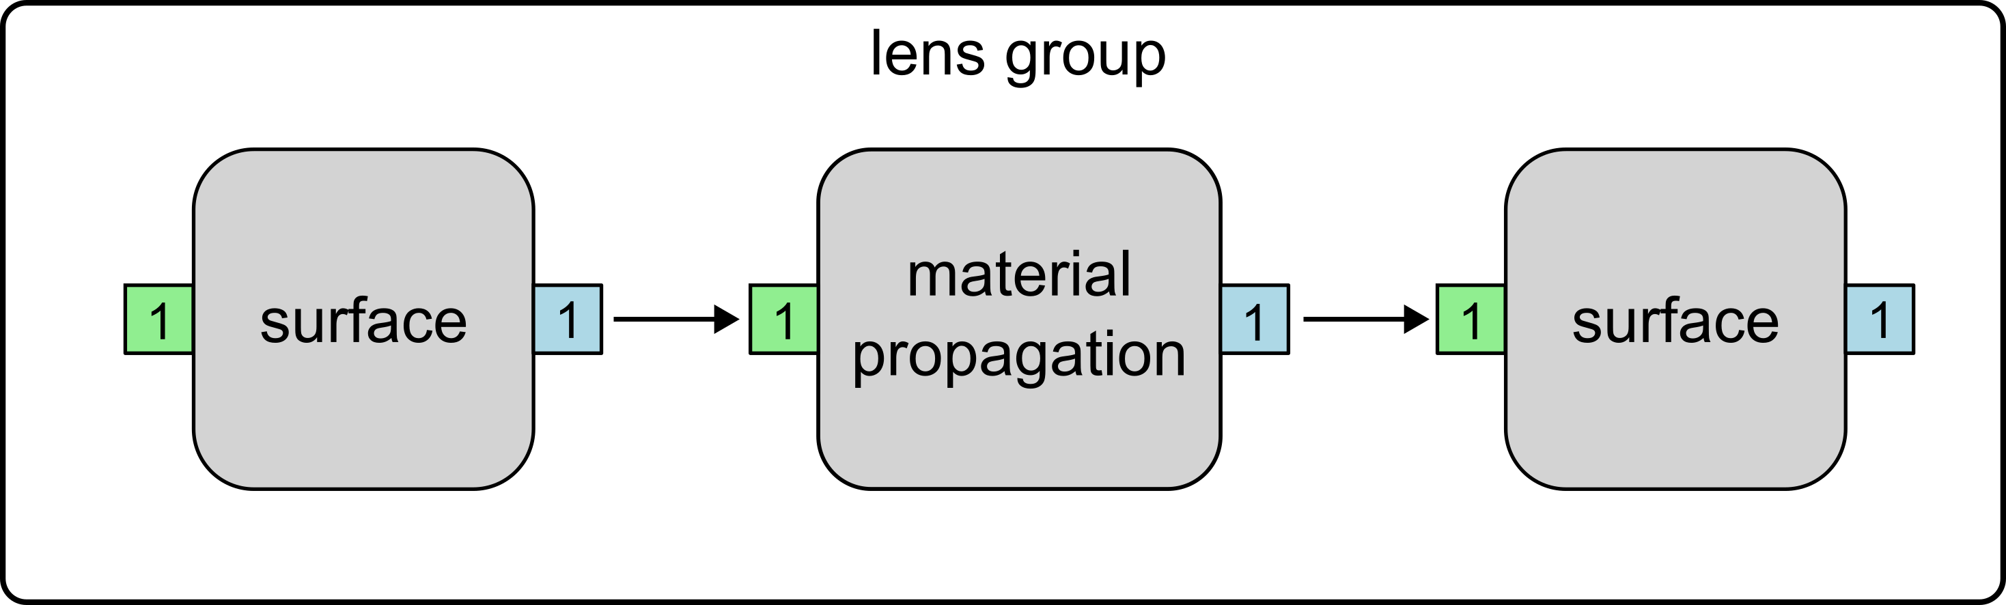
Examples
Simple filter system
report
60% / 40%
50%
Nodes can be grouped and infinitely nested
Example "real" lens:
Photo by GSI / J. Hosan

Slide 6
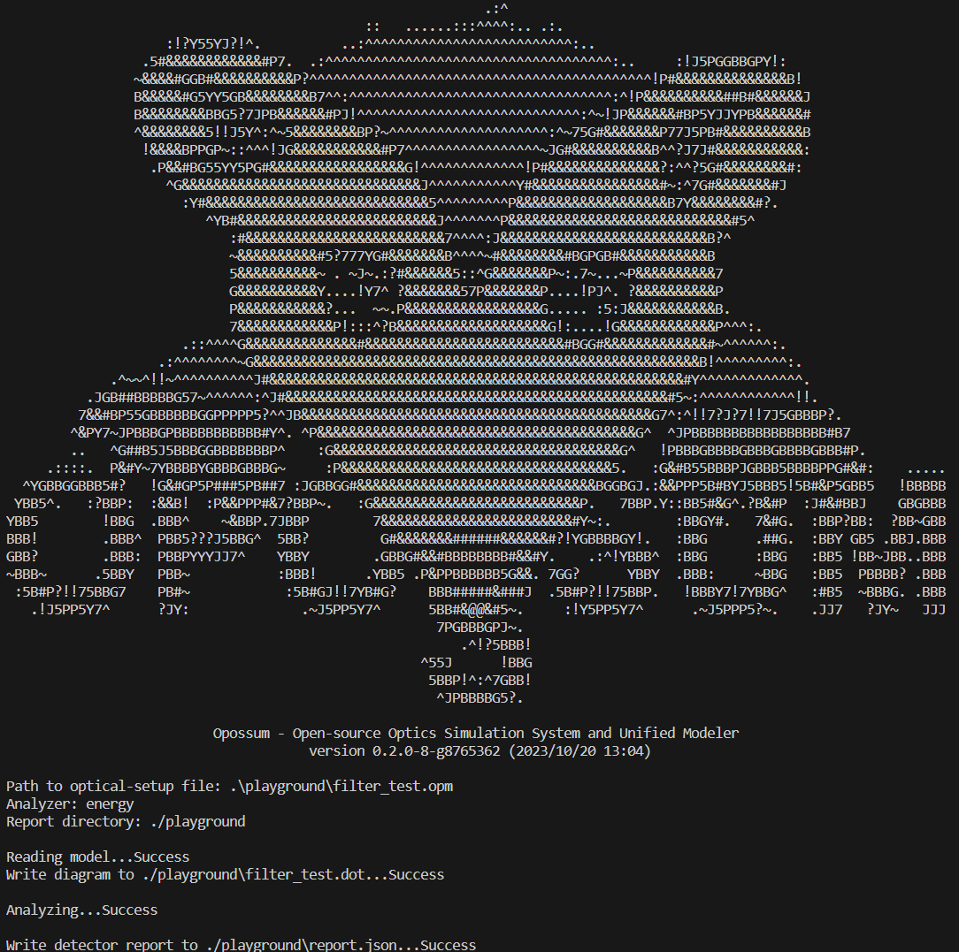
Current Project Status
Optical model concept worked out
OPOSSUM v.0.2.0
Technical concept preview
> 6000 lines of code
Basic command line interface (CLI)
Read-in of setup files, json-report output
Implementation of first simple nodes
light source, detector, ideal filter, beam splitter, node groups etc.
Energy analyzer
Photo by GSI / J. Hosan

Slide 7
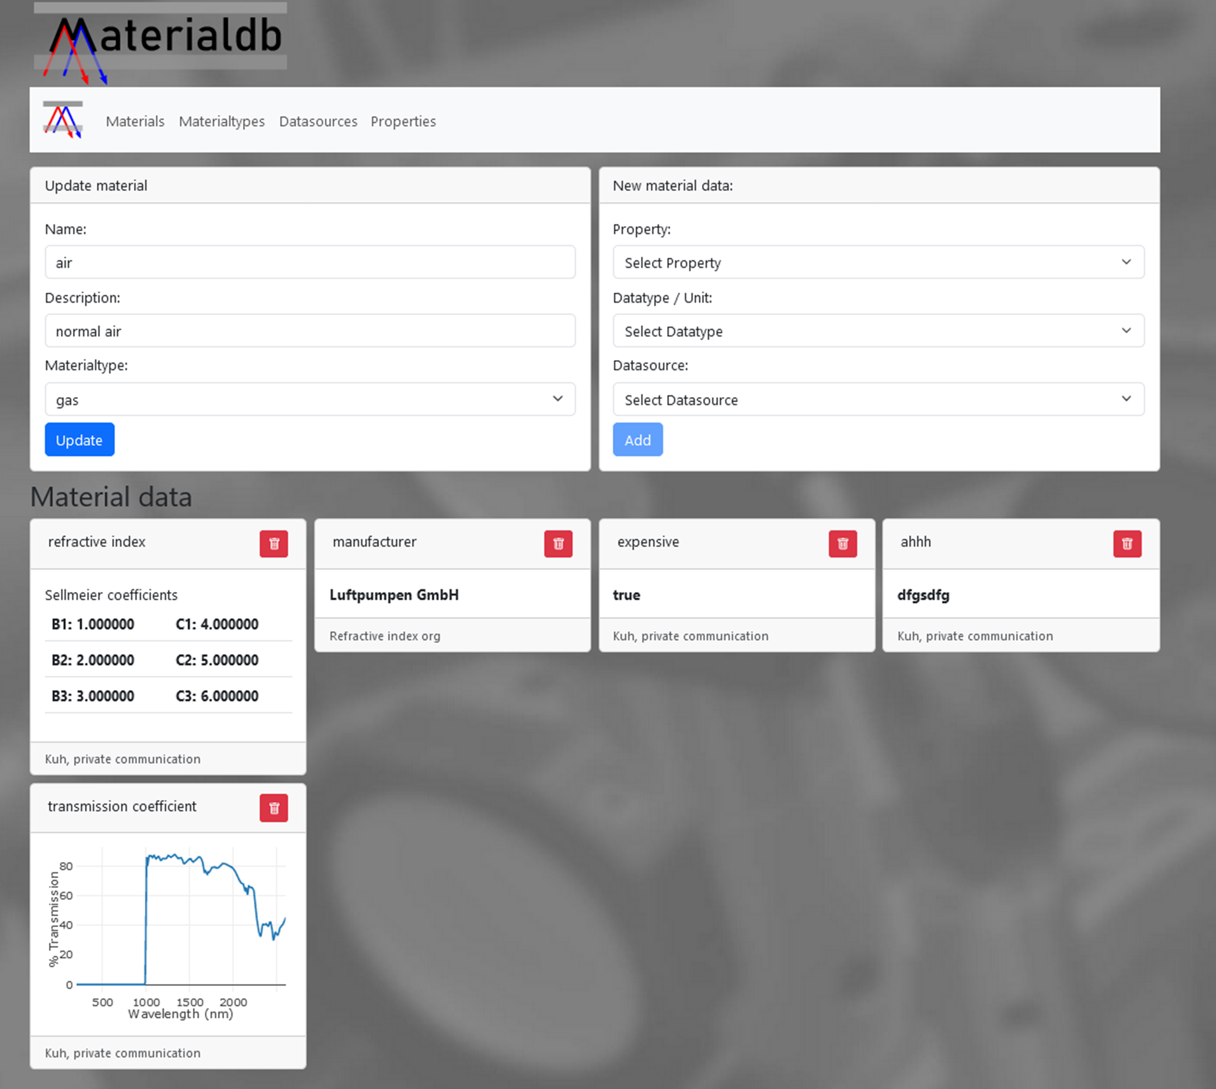
Opossum ecosystem
MaterialDB
Database for arbitrary material parameters
DB backend / web frontend architecture
First preview version available
OpticDB
DB of standard optical elements
In conception / planning
OPOSSUM Reporter
Generation of OPOSSUM analysis reports
In conception / planning
Photo by GSI / J. Hosan

Slide 8

outlook
Planned milestones
V0.3: implementation of basic ray-tracing (wavelength and polarization dependent)
V0.4: inclusion of first external code module (Python SHG simulation by M. Malki)
V0.5: connection to MaterialDB
Other implementations
GUI
Further node-analyzer options
Whole-system ghost-focus analysis
Photo by GSI / J. Hosan

